Slide 1


AKILLI ENGELSAVAR ASİSTANI
ÇİFT KANALLI UYARI SİSTEMİ:SESLİ İKAZ VE BLUETOOTH SİSTEMİ
EGE ÜNİVERSİRESİ EGE MESLEK YÜKSEK OKULU
HAZIRLAYAN:NEFİSE KOLAYLI
DANIŞMAN: MUSTAFA BERKANT SELEK

Slide 2
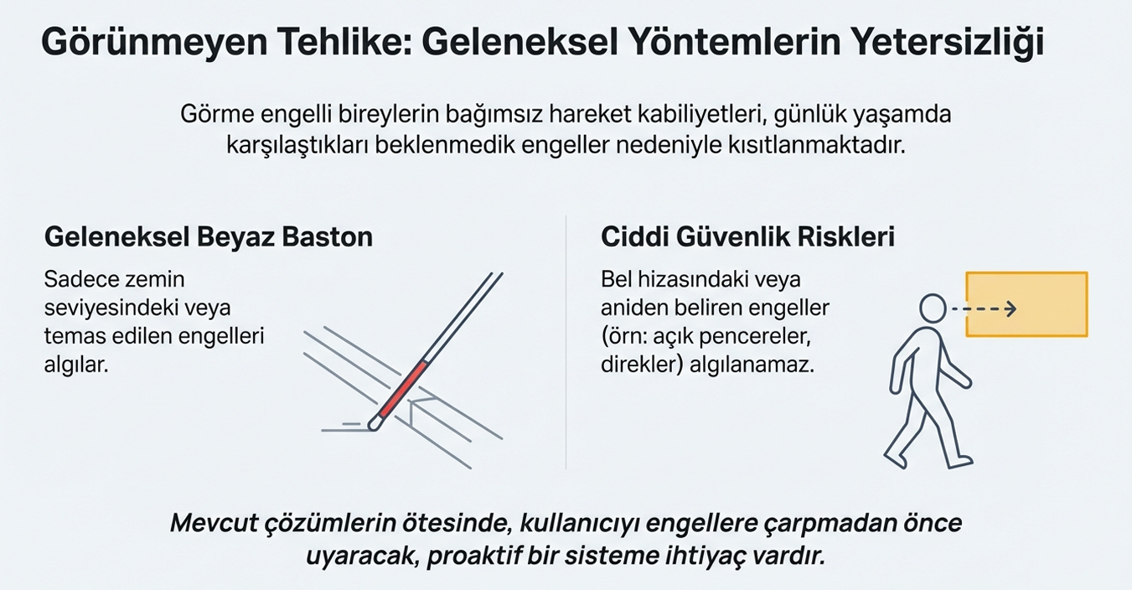

Slide 3
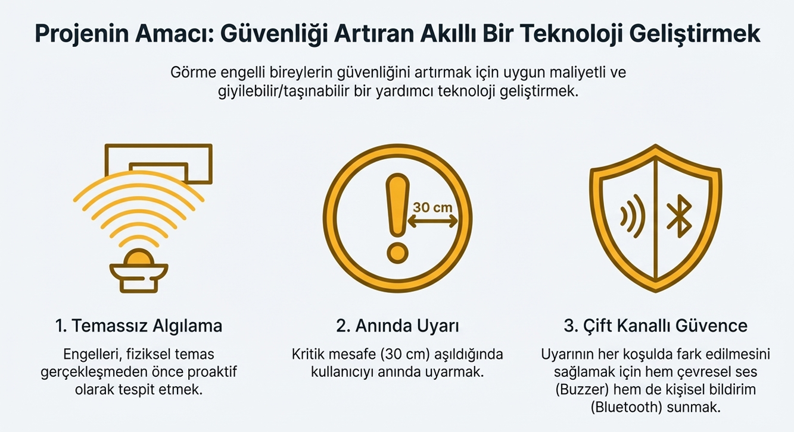

Slide 4
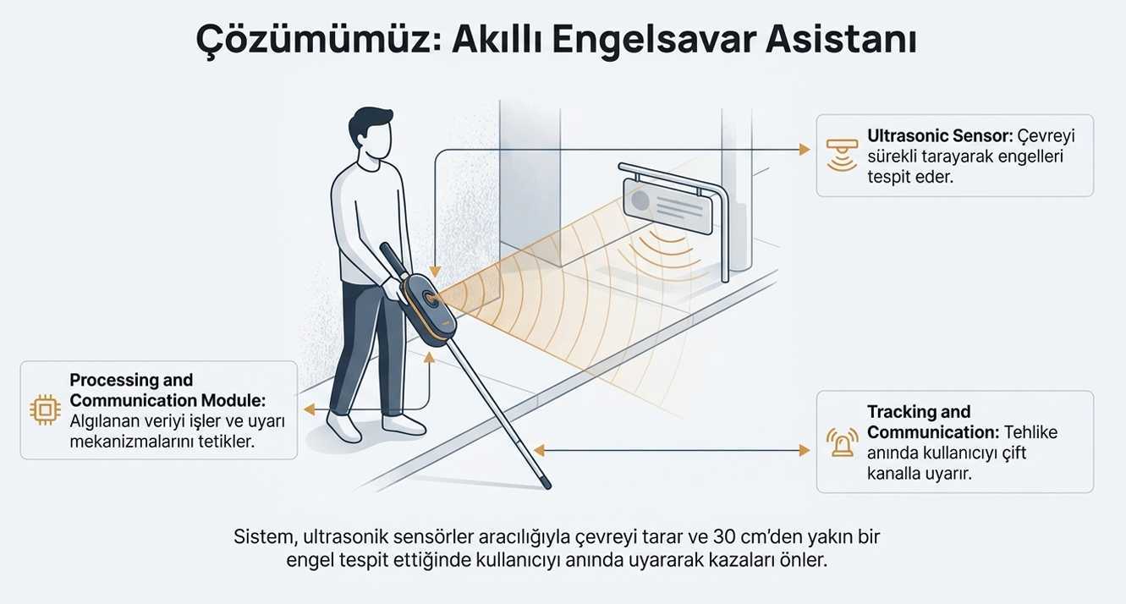

Slide 5
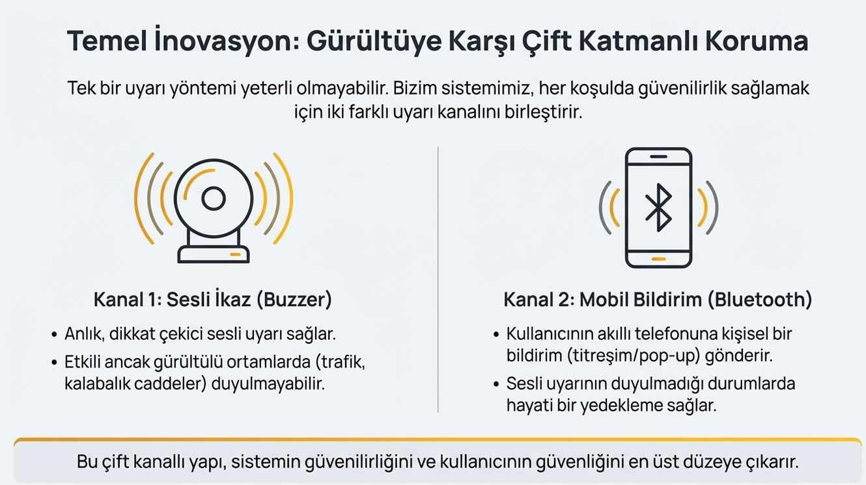

Slide 6
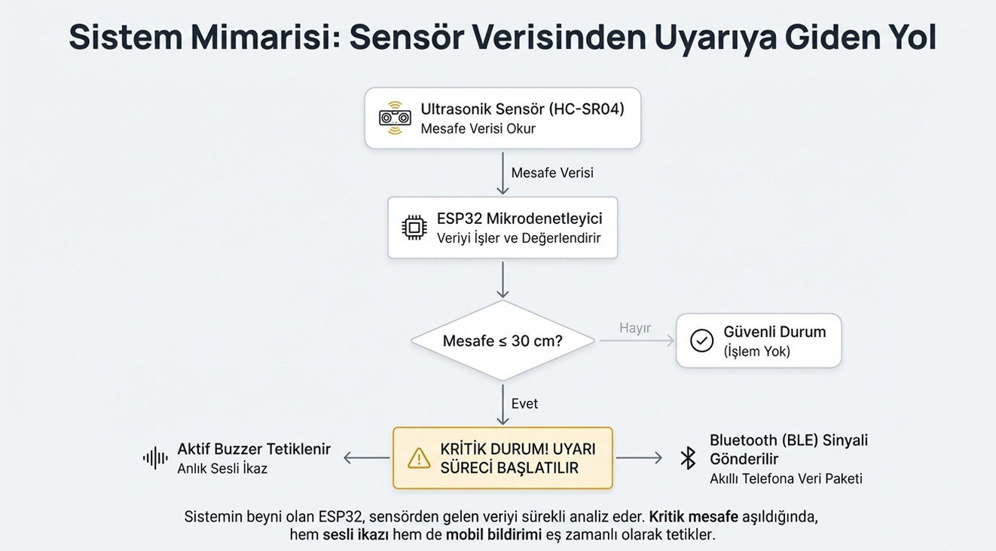

Slide 7
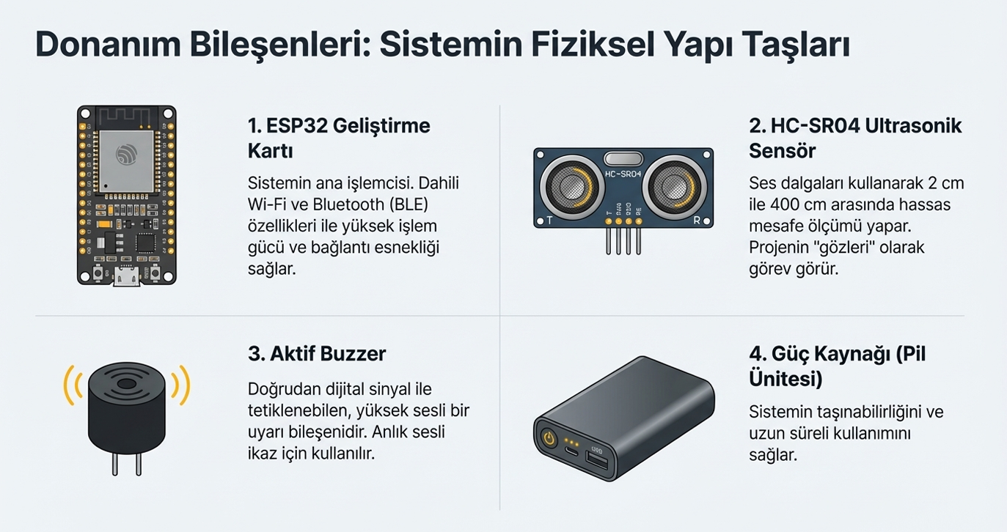

Slide 8
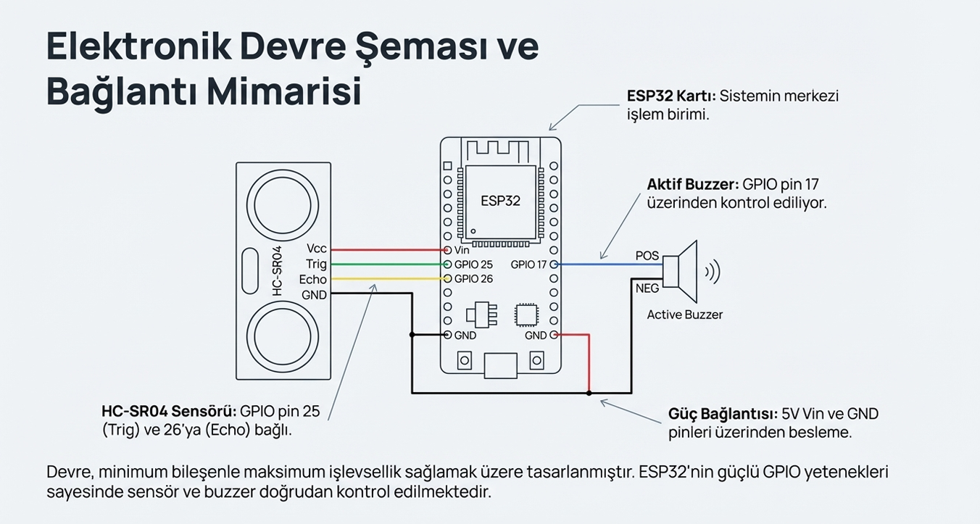

Slide 9
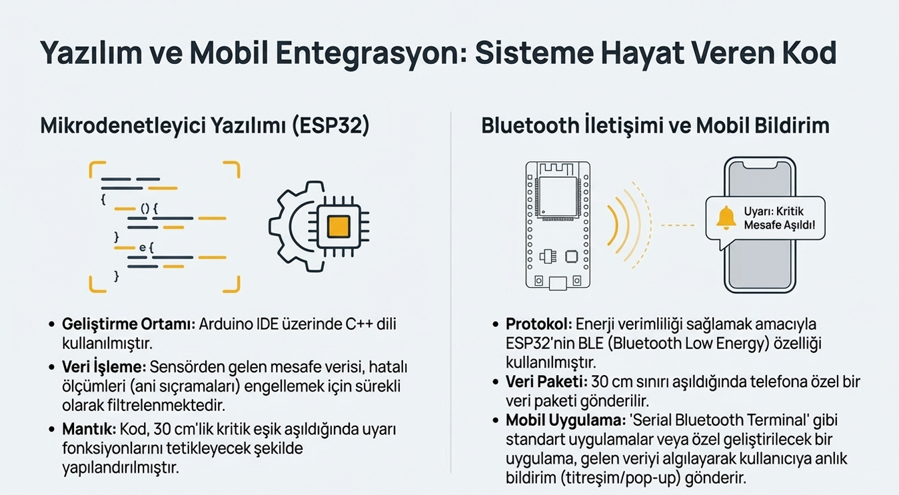

Slide 10
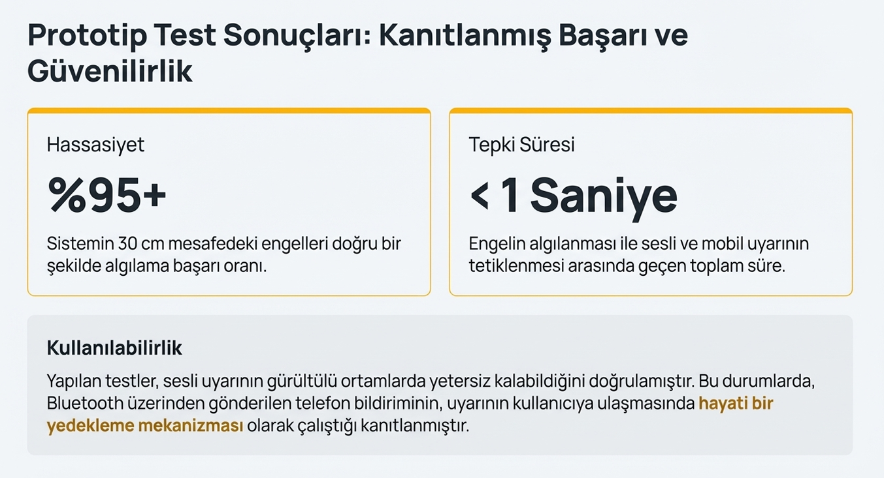

Slide 11
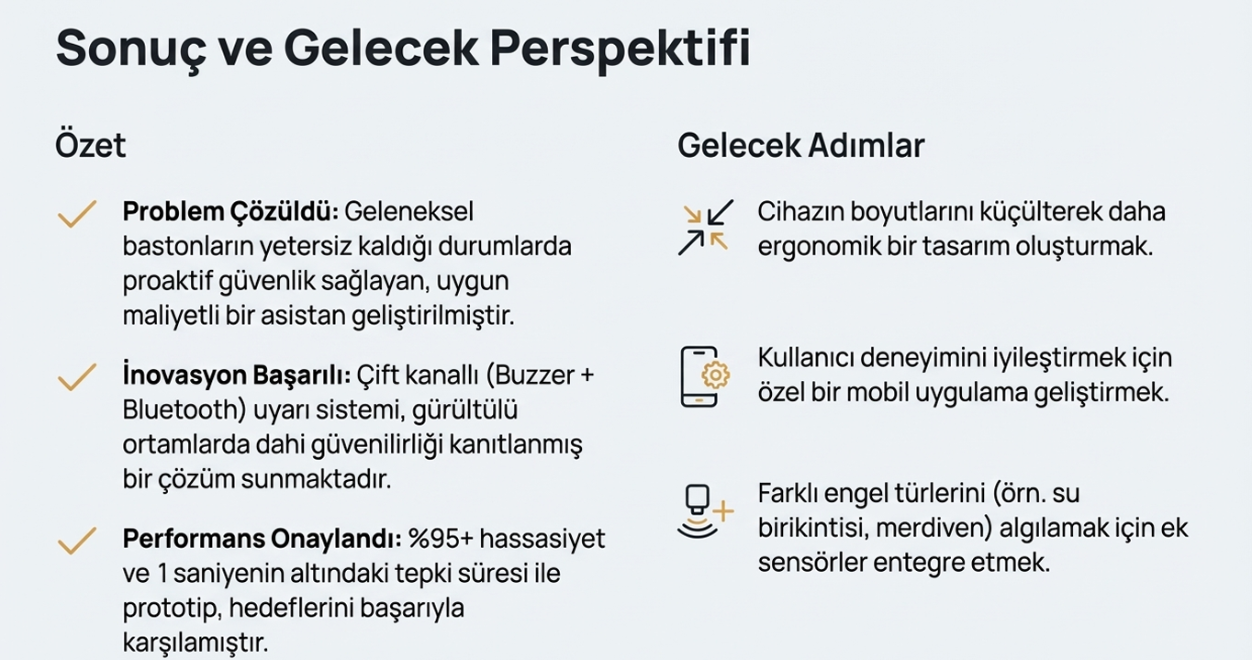

Slide 12
TEŞEKÜRLER
HAZIRLAYAN:NEFİSE KOLAYLI
GMAİL: kolaylinefisee@gmail.com
Tel no:546-675-4421

Slide 13
Kaynakça;Espressif Systems. ESP32 Series Datasheet. Espressif Systems Official Documentation. https://www.espressif.com
Espressif Systems. ESP32 Bluetooth Low Energy (BLE) Documentation. https://docs.espressif.com
Arduino. Arduino IDE Documentation. https://www.arduino.cc/en/software
HC-SR04 Ultrasonic Sensor Datasheet. Ultrasonic Ranging Module HC-SR04. https://components101.com
Y. Hersh, A. Johnson. Assistive Technology for Visually Impaired and Blind People. Springer, 2008.
World Health Organization (WHO). World Report on Vision. https://www.who.int
S. Sharma, R. Singh. “Smart Navigation System for Visually Impaired Using Ultrasonic Sensors.” International Journal of Engineering Research & Technology (IJERT), 2019.
Bluetooth SIG. Bluetooth Low Energy Overview. https://www.bluetooth.com
A. Elmannai, K. Elleithy. “Sensor-Based Assistive Devices for Visually Impaired People.” Sensors Journal, MDPI, 2017.
Ege Üniversitesi – Ege Meslek Yüksekokulu. Elektronik Haberleşme Teknolojisi Ders Notları.

